Slide 1
Video Game Sales Analysis
Name: Ritik Kumar
Tools: Python, SQL, Power BI

Slide 2
Heading: Problem Statement
Points:
Understand how video games perform across genres and platforms.
Analyze sales together with user ratings and engagement (plays, wishlist, backlogs).
Help game studios and publishers focus on the most profitable segments.

Slide 3
Heading: Datasets Used
Points:
games.csv – user ratings, genres, plays, backlogs, wishlist, release date, platform, developer.
vgsales.csv – regional and global sales by game, platform, year, genre, publisher.
Both datasets were merged on game title and platform to build a single analysis table.

Slide 4
Heading: Data Cleaning (Python)
Points:
Removed duplicate records and handled missing values in ratings, plays, and sales.
Converted values like 3.9K into proper numeric columns and standardized data types.
Normalized text fields (genre, platform, publisher names) and prepared the merged dataset.

Slide 5
Heading: SQL Database Setup
Points:
Created MySQL database video_game_db and loaded the cleaned merged table (1384 rows).
Defined appropriate column types for ratings, engagement metrics, and regional sales.
Wrote SQL queries to find top‑selling games, genre‑wise sales, platform‑wise sales, and yearly trends.

Slide 6
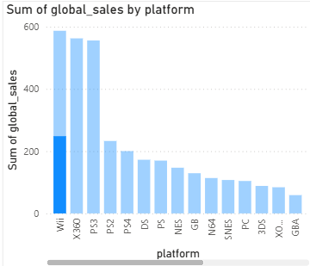
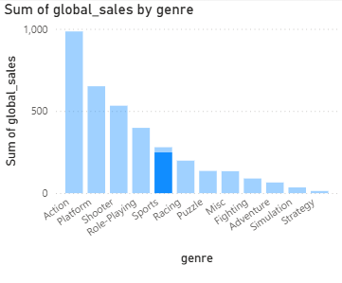
Heading: Power BI Dashboard
Content (bullet points):
Connected Power BI Desktop to MySQL database (video_game_db).
Built 2 key visuals:
  Bar chart: Sales by Platform (Wii, X360, PS3 lead the market).
  Bar chart: Sales by Genre (Action and Platform genres dominate).

Slide 7
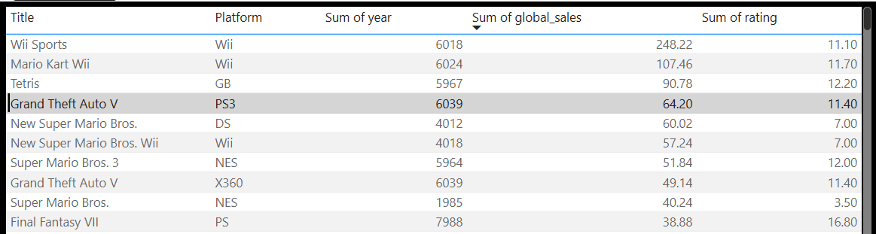
Heading: Top 10 Games by Global Sales
Table built in Power BI using merged video game dataset.
Sorted by Sum of global_sales in descending order.
Shows highest‑selling titles like Wii Sports, Mario Kart Wii, Tetris, GTA V, etc.

Slide 8
Heading: Key Insights
Content (bullet points):
Action and Platform genres generate highest global sales (~1000+ combined); Strategy/Simulation contribute minimally.
Wii, Xbox 360, PS3 dominate console sales; older platforms (NES, GBA, 3DS) have lower revenue contribution.
Blockbuster titles (Wii Sports: 248M, Mario Kart Wii: 107M, Tetris: 90M) drive disproportionate revenue.
Strong correlation observed: High user ratings + wishlist count often correlate with better sales performance.

Slide 9
Heading: Conclusion
Content (bullet points):
Successfully built end-to-end pipeline: Data Cleaning (Python) → SQL Database → Power BI Dashboard.
Identified high-performing genres and platforms for targeted marketing investment.
Dashboard can be extended with year-over-year trends and regional sales breakdowns.
Recommended: Use insights for portfolio prioritization and market forecasting in future game launches.

